Slide 1
UNITED NATIONS GLOBAL GEODETIC
CENTRE OF EXCELLENCE
MODERNISING GEOSPATIAL REFERENCE SYSTEM
CAPACITY DEVELOPMENT WORKSHOP
AI and geodesy
Liubov Poshyvailo-Strube
UN-GGCE
Additional session

Slide 2
Overview
What is AI?
Common myths about AI
AI & Geodesy
AI in Europe
EGU 2025 Assembly

Slide 3
Artificial intelligence (AI). What is that?

Slide 4
What is AI?
ISO/IEC 22989:2022
Check also: ISO/IEC 22989:2022(en) Information technology — Artificial intelligence — Artificial intelligence concepts and terminology, https://www.iso.org/obp/ui/en/#iso:std:iso-iec:22989:ed-1:v1:en

Slide 5
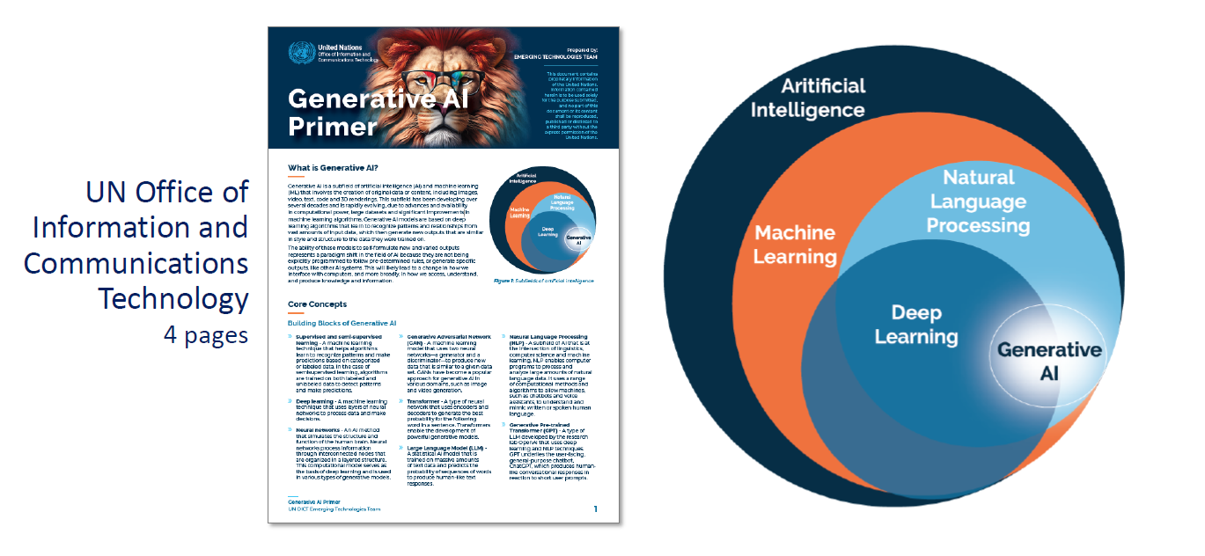
Generative AI
We can share “Generative AI Primer” with you
Generative Pretrained Transformer (GPT), https://openai.com/index/chatgpt/
Source: UN Department of Operational Support, Capacity Development and Operational Training Service (CDOTS), webinar “Effective AI Tools for Workplace Writing in English” by Catherine Thomas

Slide 6
Common myths

Slide 7
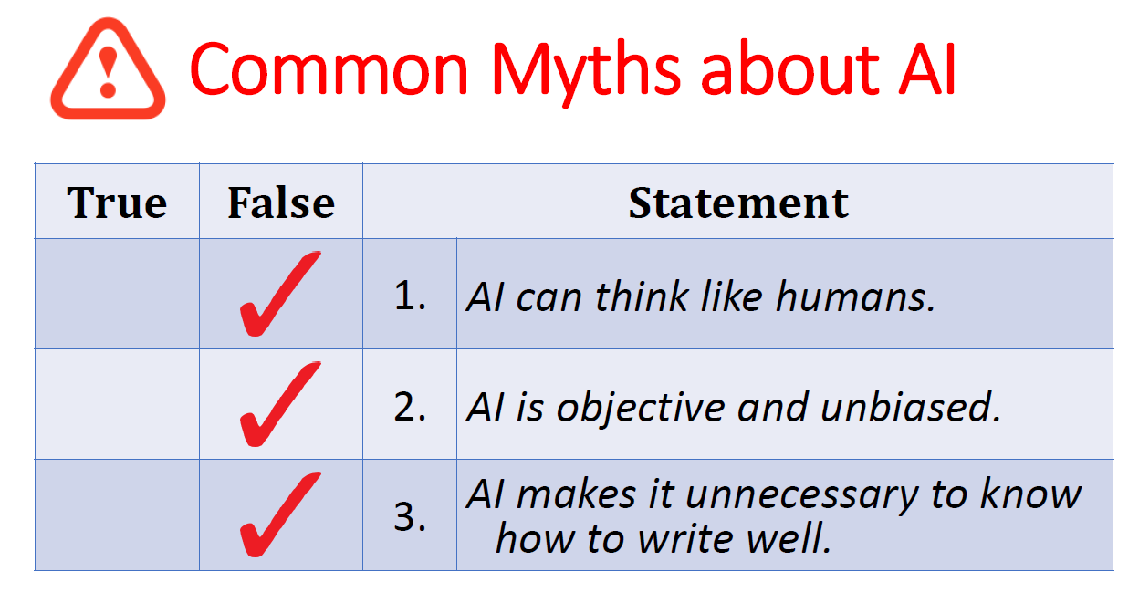
Source: UN Department of Operational Support, Instructor Capacity Development and Operational Training Service (CDOTS), webinar “Effective AI Tools for Workplace Writing in English” by Catherine Thomas

Slide 8
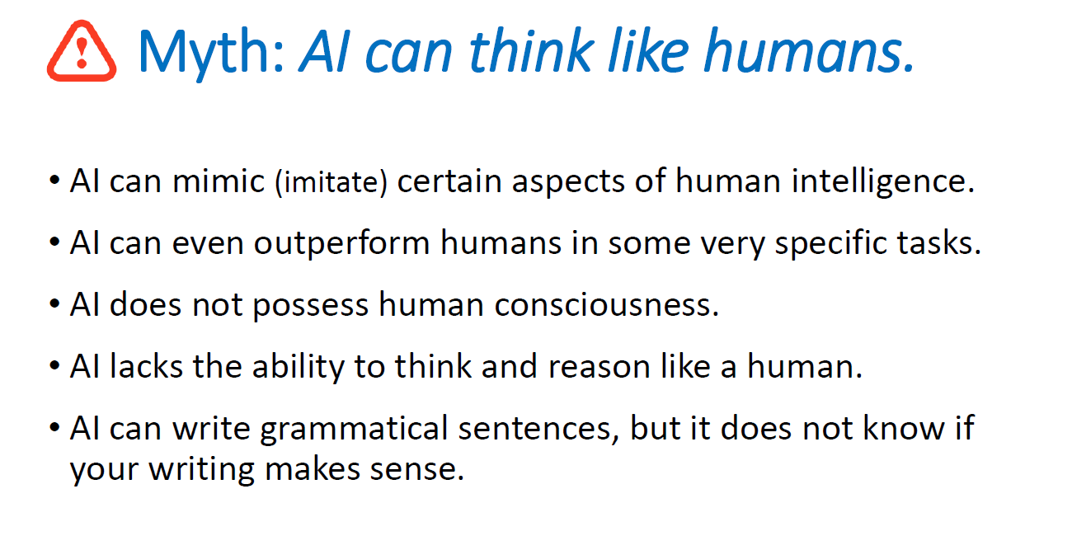
Source: UN Department of Operational Support, Instructor Capacity Development and Operational Training Service (CDOTS), webinar “Effective AI Tools for Workplace Writing in English” by Catherine Thomas

Slide 9
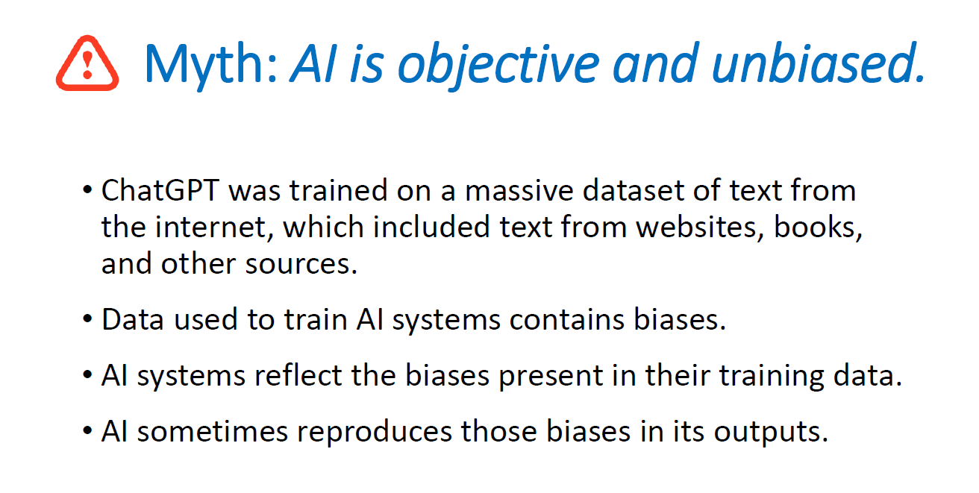
Source: UN Department of Operational Support, Instructor Capacity Development and Operational Training Service (CDOTS), webinar “Effective AI Tools for Workplace Writing in English” by Catherine Thomas

Slide 10
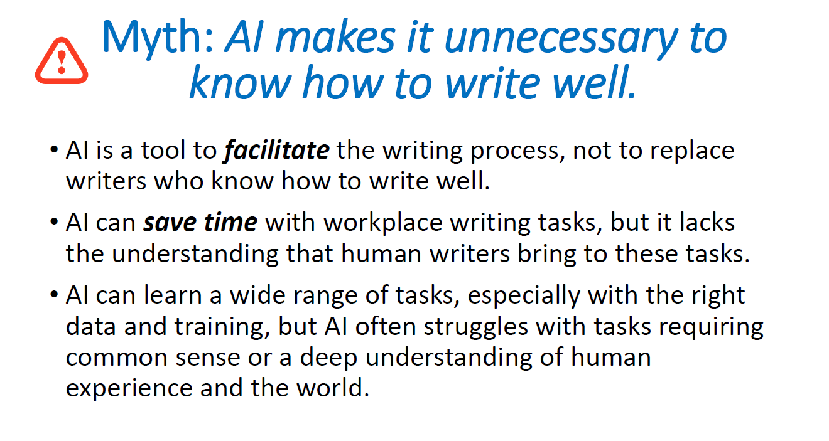
Source: UN Department of Operational Support, Instructor Capacity Development and Operational Training Service (CDOTS), webinar “Effective AI Tools for Workplace Writing in English” by Catherine Thomas

Slide 11
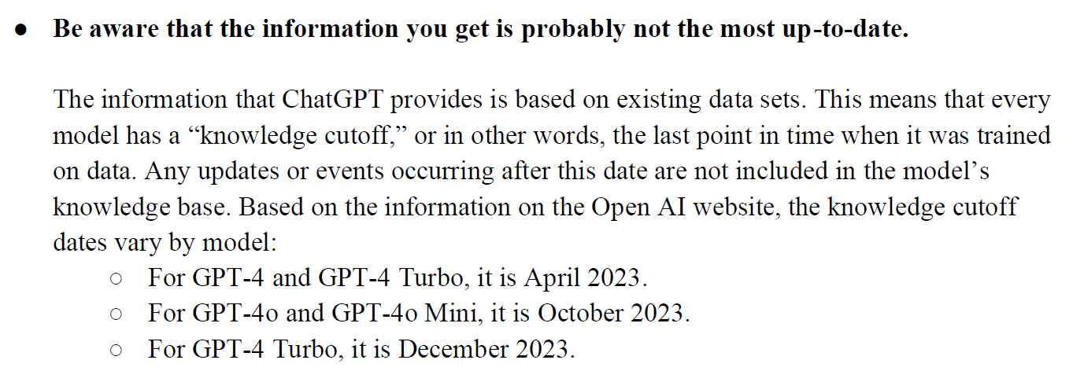
Source: “How ChatGPT Can Support Daily Work”, Programme on Youth Unit, distributed within the UN

Slide 12
AI & Geodesy

Slide 13
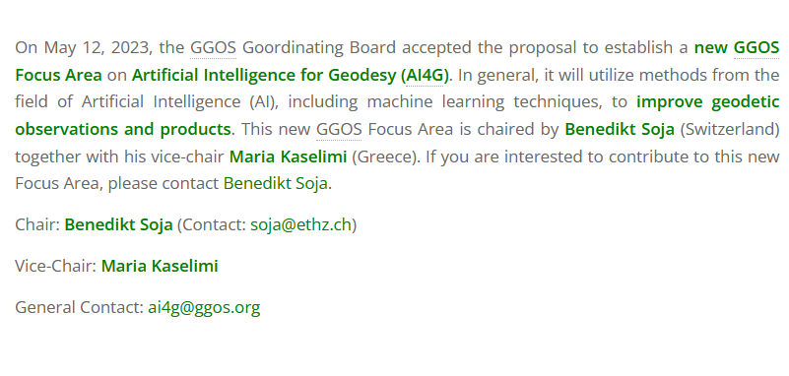
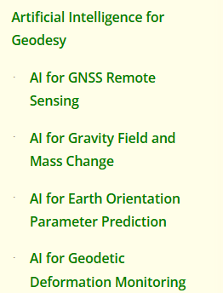
GGOS Focus Area: Artificial Intelligence for Geodesy – AI4G
study groups:
Source: https://ggos.org/about/org/fa/ai-for-geodesy/

Slide 14
GGOS Focus Area: Artificial Intelligence for Geodesy – AI4G
AI have the potential to facilitate
automation of data processing
detection of anomalies in time series and image data
modelling spatiotemporal data
creating enhanced geodetic products
Objective #1 Develop improved geodetic products based on AI and machine learning
explore the potential of AI and machine learning methods in improving the quality and accuracy of geodetic observations and products
develop new approaches and methods that can help extract valuable information from large and complex geodetic datasets and use this information to create more accurate and reliable products
Objective #2 Evaluate improved geodetic products based on AI and machine learning
developing new techniques for error assessment and uncertainty quantification, and identifying potential sources of errors in the results
Source: https://ggos.org/about/org/fa/ai-for-geodesy/

Slide 15
AI in Europe

Slide 16
Artificial Intelligence Cooperation Unit
Democratising AI for a data-driven future
Helmholtz Association of German Research Centres is the largest scientific organisation in Germany. It is a union of 18 scientific-technical and biological-medical research centres
Helmholtz AI is an application-driven artificial intelligence platform accelerating science across the Helmholtz Association
Objective: to enable the development and implementation of AI solutions while promoting collaboration and ensuring access to resources and expertise
Source: https://www.helmholtz.ai/
* Only for Helmholtz centres

Slide 17
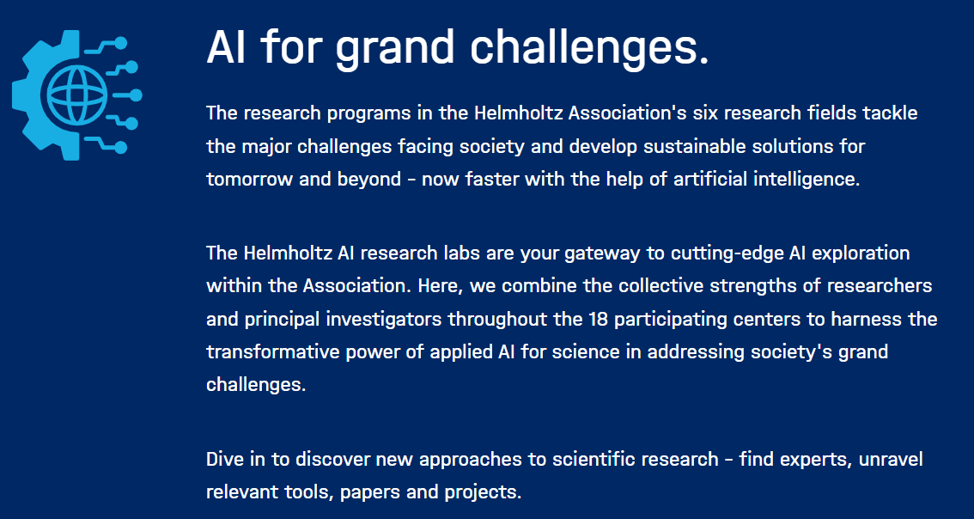
Helmholtz AI https://www.helmholtz.ai/you-helmholtz-ai/computing-resources/
Access to supercomputers in Europe
https://eurohpc-ju.europa.eu/access-our-supercomputers_en
Source: https://www.helmholtz.ai/

Slide 18
Helmholtz Research centre Juelich (FZJ) AI ChatBot
BLABLADOR, https://helmholtz-blablador.fz-juelich.de
ChatBot providing multiple Open Source models
Hosts models developed in Jülich, as well as the most common AI
Can be used via the website or via programming APIs
No user data is ever stored. Maximum privacy
Anyone with Eduroam, ORCID, Google or GitHub account can use it
AI consulting at FZJ, feel free to contact them, https://www.fz-juelich.de/en/ias/jsc/about-us/structure/divisions/large-scale-data-science/ai-consultant-team
Courses from the FZJ supercomputing centre https://www.fz-juelich.de/en/ias/jsc/news/events/training-courses/2025
The Jureca DC Supercomputer in Jülich running Blablador © Forschungszentrum Jülich

Slide 19
Regulations, recommendations, guidelines
Commission Guidelines on prohibited artificial intelligence practices established by Regulation (EU) 2024/1689 (AI Act), https://digital-strategy.ec.europa.eu/en/library/commission-publishes-guidelines-prohibited-artificial-intelligence-ai-practices-defined-ai-act
Geospatial data
Geospatial predictive data
Right of privacy
. . .
Regulation (EU) 2024/1689 of the European Parliament and of the Council of 13 June 2024 laying down harmonised rules on artificial intelligence, https://eur-lex.europa.eu/eli/reg/2024/1689/oj/eng
. . .

Slide 20
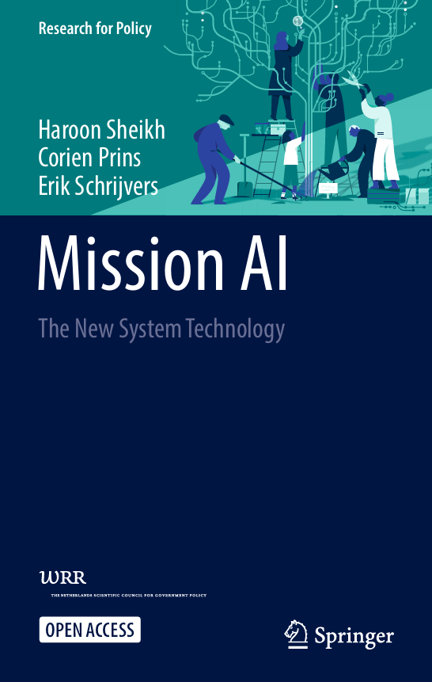
Regulations, recommendations, guidelines
https://digitallibrary.un.org/record/4062495?v=pdf
https://link.springer.com/book/10.1007/978-3-031-21448-6

Slide 21
UN2.0, AI, “geo-”, space, science… General trend
UN 2.0 https://un-two-zero.network/
Notes:
To accelerate progress, everyone needs to rethink, refocus, and recharge. “UN 2.0” is a vision of a modernized UN system: cutting-edge skills and forward-thinking culture that enable UN entities to better contribute to the quest for the SDGs.
These ongoing internal transformations are designed around a “Quintet of Change”:
Innovation: Learning to scale new solutions, e.g., to help expand access to healthcare services.
Data: Building impactful data ecosystems, e.g., to help raise yields with data-driven agriculture.
Digital: Becoming fluent in digital impact, e.g., to help with inclusive online education platforms.
Foresight: Learning to navigate uncertainty, e.g., to assist in adapting to climate change trends.
Behavioural science: Enabling better choices, e.g., to help enhance access to social services.

Slide 22
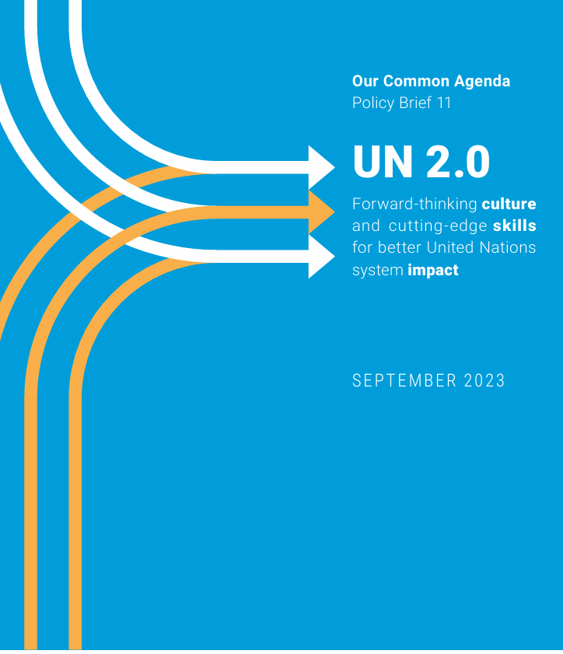
UN2.0, AI, “geo-”, space, science… General trend
https://digitallibrary.un.org/record/4021171?v=pdf
https://digitallibrary.un.org/record/4063333?v=pdf

Slide 23
European Geosciences Union (EGU) Assembly: 27 April – 2 May 2025

Slide 24
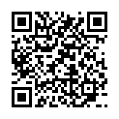
EGU25 waiver for European policymakers
Source: https://www.egu.eu/forms/EGU25PolicyWaiverRequest/

Slide 25
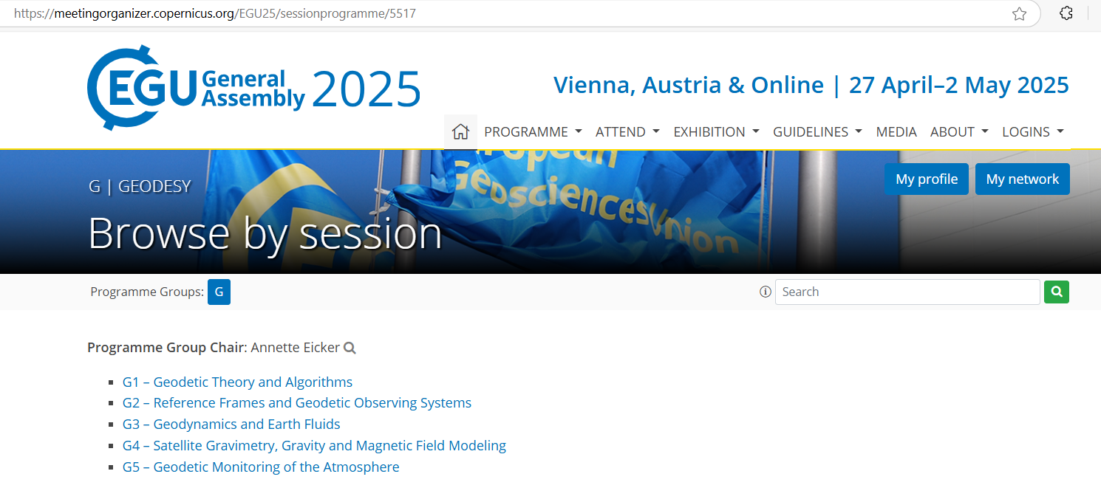
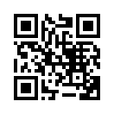
EGU25 Assembly
Source: https://www.egu25.eu/

Slide 26
EGU24 > 15 AI & ML sessions
Geosciences
Earth sciences
Space sciences
Planetary science
Climate sciences
Hydrology
Ionosphere / thermosphere
Antarctic
Spatiotemporal data
Source: https://www.egu24.eu/

Slide 27
EGU24 > 15 AI & ML sessions
Cryospheric modelling
Large-scale, regional, and continental mapping
Natural hazards
Disaster management
Scientific publishing
Ethical AI in Earth, space, environmental sciences
Source: https://www.egu24.eu/

Slide 28
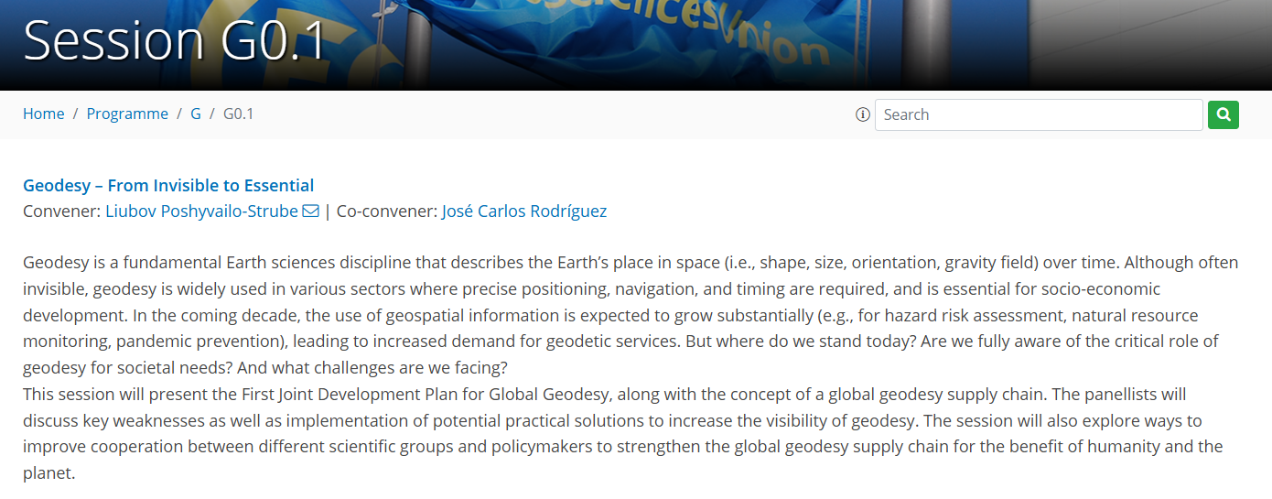
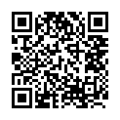
EGU25 Special Session on Geodesy
Source: https://meetingorganizer.copernicus.org/EGU25/session/54622

